Slide 1
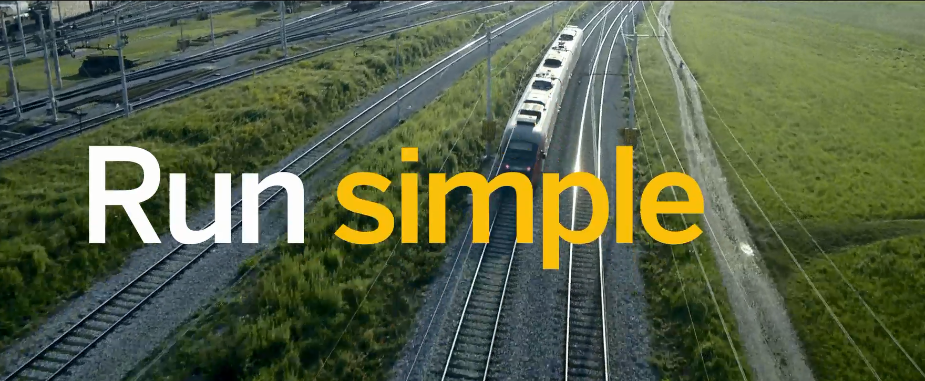


HANA Development Curriculum

Slide 2
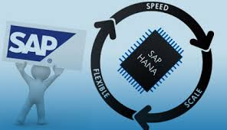
What is HANA?
A database…
An application server…
An analytics platform…
An enterprise class transaction
Server…
In the cloud and on premise…

Slide 3
HANA Application Development
SAP has adopted an open approach to application development making it easier to develop applications for HANA
Cloud and hybrid implementations of enterprise systems create a demand for custom applications
The move to Fiori with S/4HANA increases the demand for HANA application development skills

Slide 4

The New HANA Development Curriculum

Slide 5
New HANA Development Curriculum
Learn SAPUI5
HANA Core Data Services
HANA Cloud Platform
Live3 Social Data Analytics
Mobile Applications with HAT
Internet of Things
Design for User Experience

Slide 6
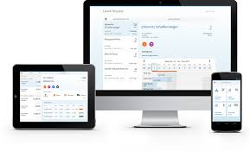
Learn SAPUI5
Audience: Beginning to intermediate programming
SAPUI5 is a HTML5/JavaScript framework which is the foundation of SAP’s new approach to UX using Fiori.
This curriculum will include application development cases that cover many of the skills required to develop applications using SAPUI5
It will also include application design using SAP’s UX philosophy

Slide 7
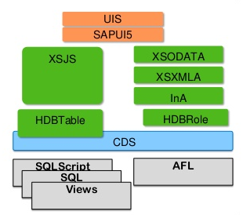
HANA Core Data Services
Audience: Beginning to intermediate database or programming
Core Data Services (CDS) is an infrastructure that can be used by database developers to create the underlying (persistent) data model which the application services expose to UI clients.
This curriculum will include cases that range from data modeling, service development and application development.
There is a full and lite version.

Slide 8
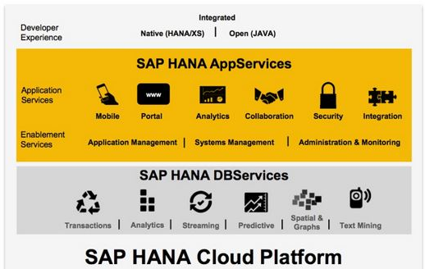
HANA Cloud Platform
Audience: Beginning to intermediate application development classes Individual cases could be used in other courses to illustrate cloud concepts
SAP HANA Cloud Platform (HCP) is SAP’s Platform as a Service (PaaS) for creating web based applications that integrate and extend on premise and cloud applications.
This curriculum will include cases that illustrate the various capabilities of SAP HCP.

Slide 9
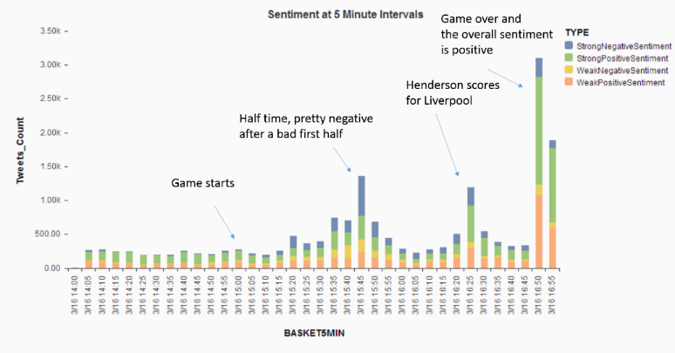
Live3 Social Networking Analysis
Audience: Analytics classes, application development classes
Based on the HANA Academy Live3 series of videos
Live capture of Twitter stream
Sentiment analysis, clustering, geo-spatial analysis
SAPUI5 application to manage the process and report the results
Skills include SQL, text analysis, analytics, visualization using Lumira, SAPUI5, Node.js

Slide 10
Mobile Applications with the Hybrid Application Toolkit
Audience: Intermediate to advanced programming classes
The Hybrid Application Toolkit is a plugin for the WebIDE on the SAP HANA Cloud Platform that facilitates developing native mobile applications using HTML5.

Slide 11

Internet of Things
Audience: Intermediate to advanced programming classes
HANA is the perfect platform to store and process data from remote sensors and other devices. This curriculum will use a Raspberry Pi to gather data such as temperature data, feed it to a HANA system (both in the cloud and on premise) and create applications to monitor and display the data.
Requires Java, JavaScript as well as some familiarity with hardware.

Slide 12
Design for User Experience
Audience: Open
SAP, along with many other companies, have begun to emphasize User Experience (UX) and design. An emphasis on UX can not only improve users’ satisfaction with applications but can directly effect the bottom line.
This curriculum will consist cases and exercises that teach the value of design and approaches to design and improved UX.

Slide 13
Thank you
Contact information:
Ross Hightower
Director, SAP UCC at UWM
hightowe@uwm.edu

